Slide 1
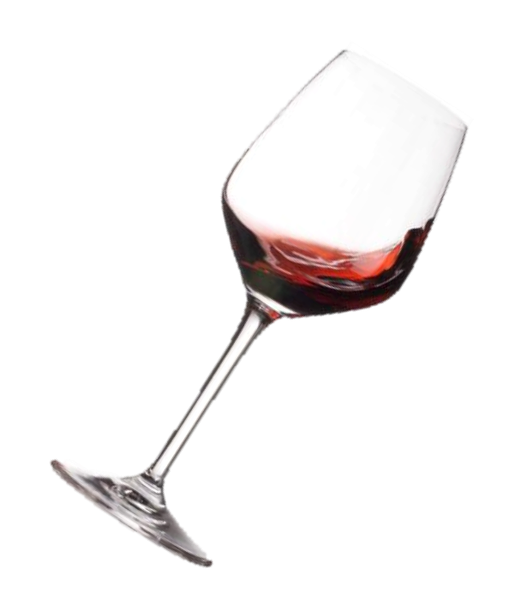
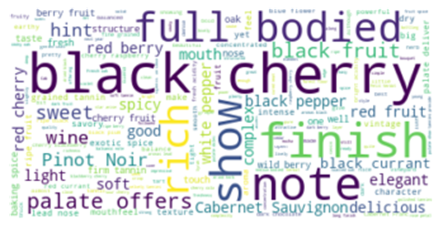
Wine Analysis
David Primrose, Kristen Logue, Richard Bump, and Trevor Kahl

Slide 2


What is the Data?
Country, providence and regions of origin of wine
Description of wine
Designation of wine
Points awarded to wine
Price of one bottle of wine
Information on points awarder
Variety of wine
Winery the wine is made in

Slide 3
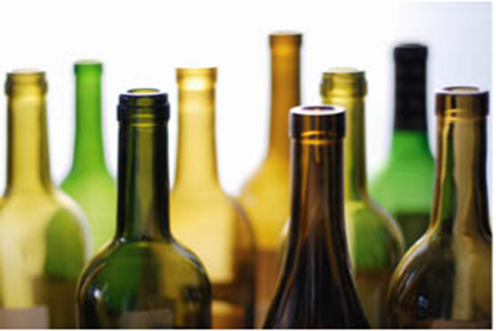
Wine Data Analysis
Preparation
Adjustments
Removed wine $300 or more
Removed Taster, Twitter, Title Columns
Reduced observations set to 25,241 from 164,000
13 countries, 13 features, 159 wines
Filled in average prices where winery range was incomplete
Replaced NaN in Region 1 & Region2 with None
Added physical winery addresses where possible; this became unwieldy
Enhanced dataset with Geo-Location data
Enhanced dataset with Weather data
Enhanced dataset with GDP data
Enhanced dataset with Sentiment data

Slide 4
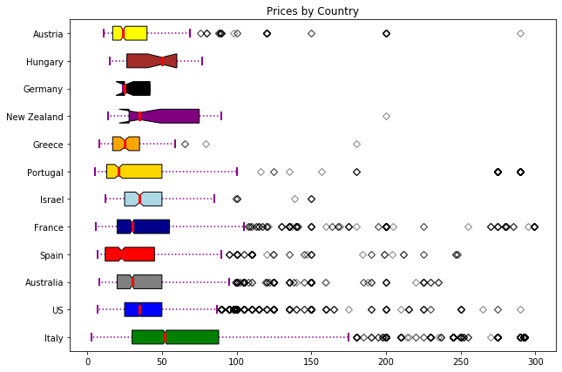
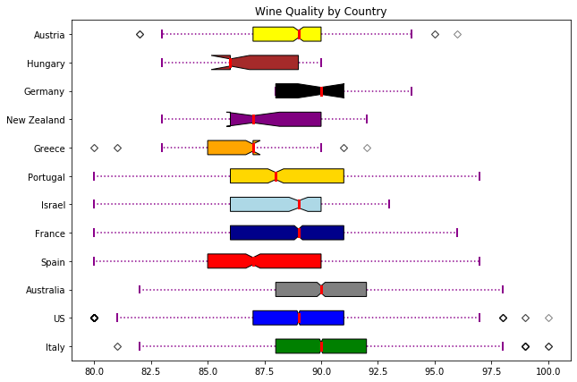
Does the country of origin affect wine prices or quality?
It seems as if Italy and France that have more expensive bottles but aren't too differentiated in terms of quality.

Slide 5
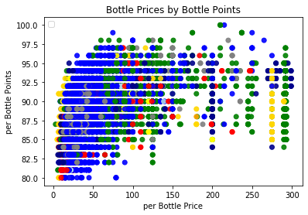
Does the country of origin affect wine prices or quality?
Looking at the prices of the wines relative to the quality by country there are a couple of perceptible patterns
US (Blue) lower in price and runs most of the quality
Italy (Green) is more expensive and is also the highest quality
The rest of the countries are not quite as expensive as Italian wine

Slide 6

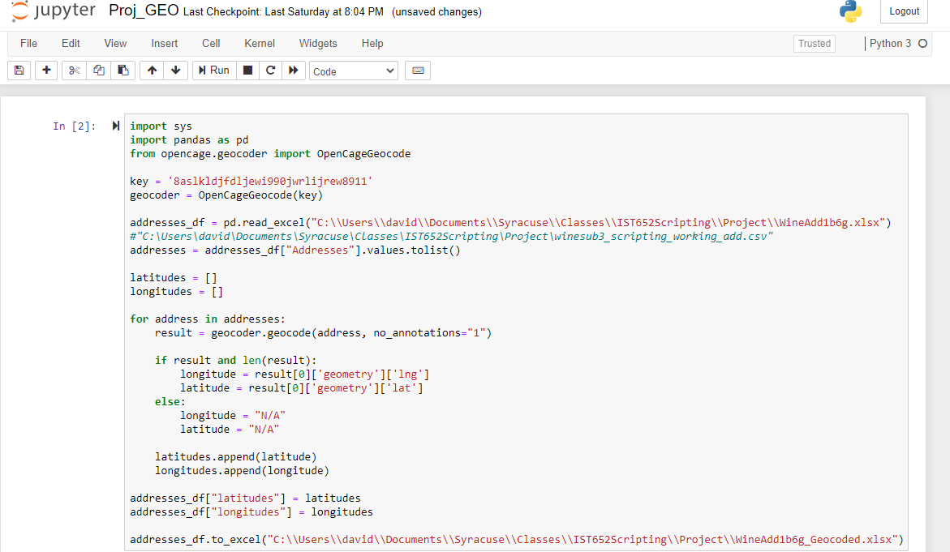
Analysis of Geocode
Think ahead…address, region, landmark?
Geocode from code…ie Python if possible
Double check your counts
Start with small amounts – 10-20
Max with excel plug-in is 500-1000
Check often or waste hours
Sometimes can get 10K + but not reproducible
Still lots of fun!

Slide 7
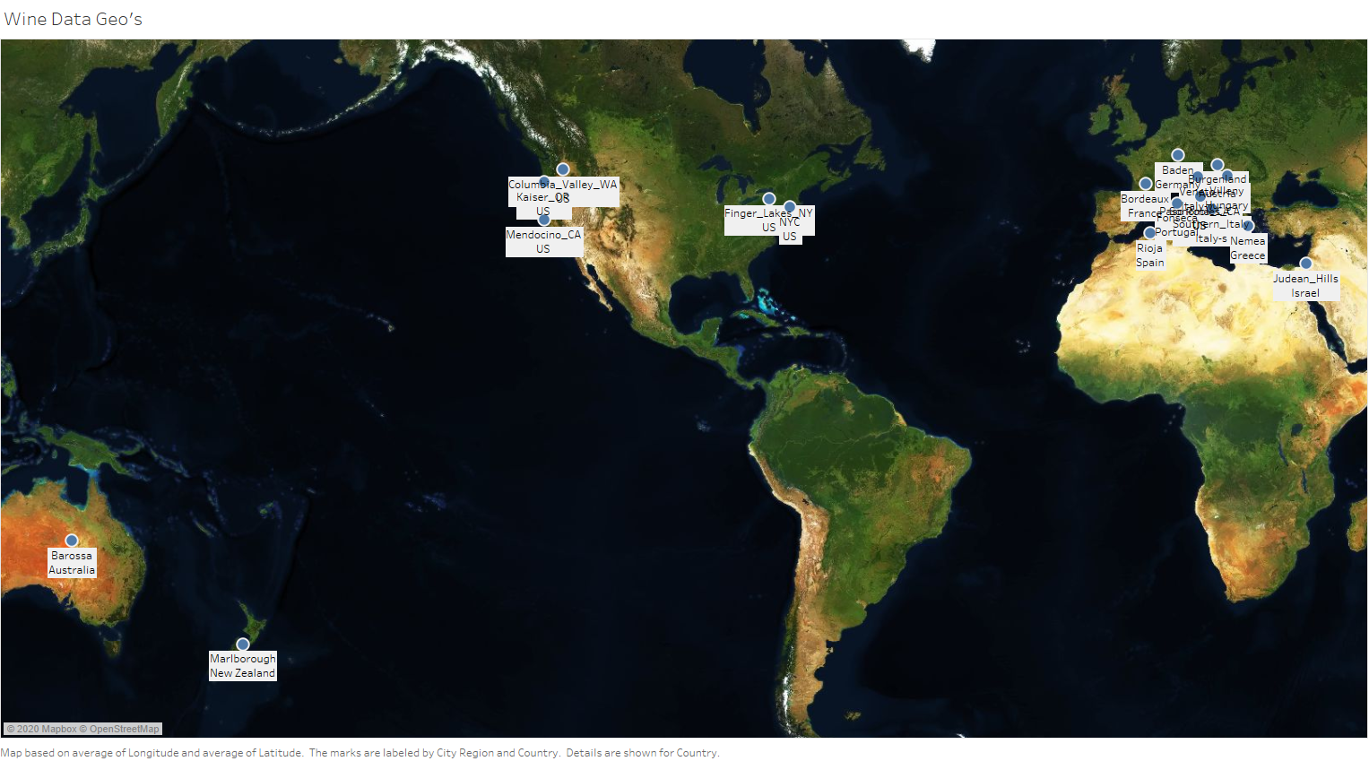
Analysis of Geocode
City_Region | Country | Latitude | Longitude
Barossa | Australia | -23.4 | -221.92
Burgenland | Austria | 47.47 | 16.47
Bordeaux | France | 44.66 | 1.43
Baden | Germany | 48.75 | 8.27
Nemea | Greece | 38.17 | 22.76
Villeny | Hungary | 45.86 | 18.46
Judean_Hills | Israel | 31.68 | 34.91

Slide 8
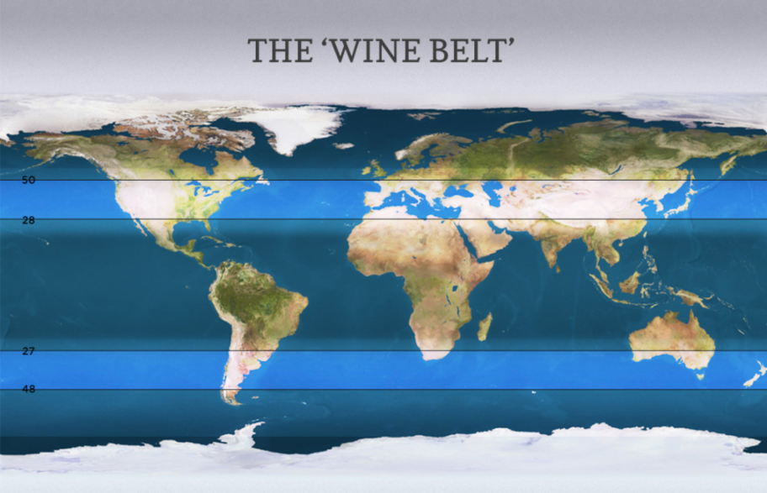
Does Weather Affect Wine Quality?
Preparation:
Split countries into Northern and Southern Hemisphere to compensate for different ripening seasons
Pull in average temperature and rainfall data for the ripening season of each region represented
Joined the weather dataframe to the wine dataframe
Average Temperature:
Across all regions – 76.8F
Lowest average – 68F in Germany and parts of Austria
Highest average – 100F in Arizona, USA
Average Rainfall:
Across all regions – 1.82in
Lowest average - .29in in Adelaida District, California, USA
Highest average – 4.16in in Augusta, Missouri, USA

Slide 9
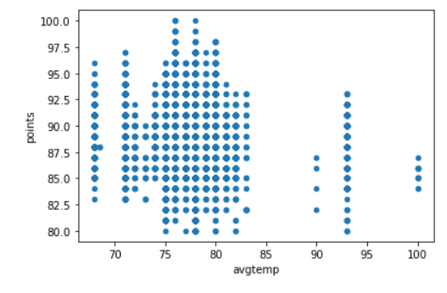
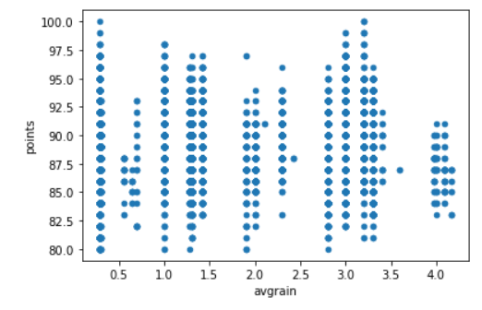
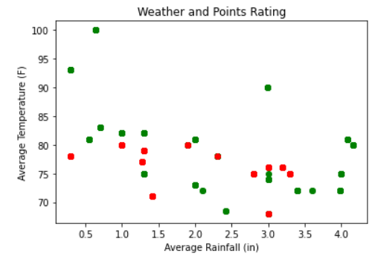
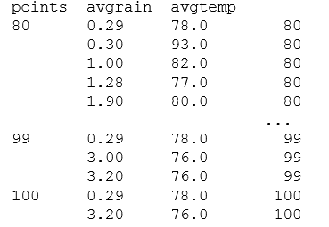
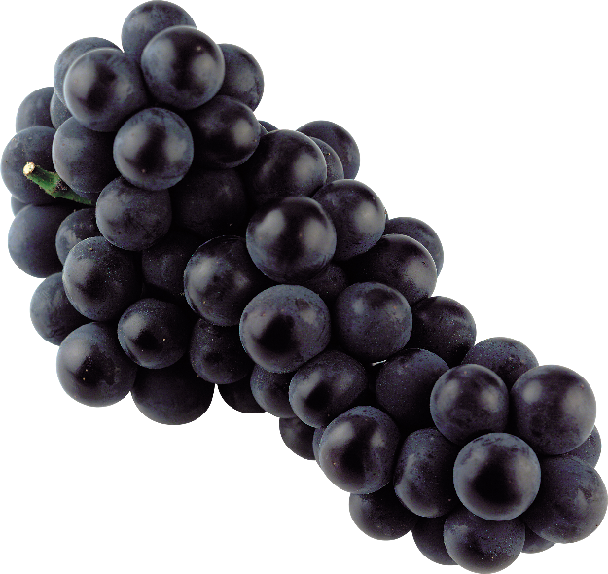

Does Weather Affect Wine Quality? (cont.)
Cabernet Sauvignon from Napa Valley, CA
Prugnolo Gentile from Vin Sano, Italy
Red: Points rating <= 94
Green: Points rating >= 95
Notes:
Avg temp with highest rating (99-100 points): 76-78F
Avg rainfall with highest rating (99-100points): .29in, 3-3.2in

Slide 10
Preparation:
Analysis of GDP
Pulled in csv file from worldbank.org
Stripped out blank/empty rows and columns
Transformed data to allow joining of the GDP data to the master wine dataframe (i.e. United States to US)
Joined the dataframes with a left join with the master wine data frame on the left
Calculated the compounded annual growth rate for the countries producing wine that are in the data set
Added the color by country for graphing

Slide 11
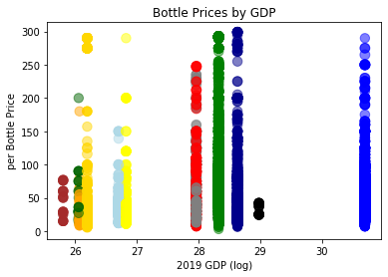
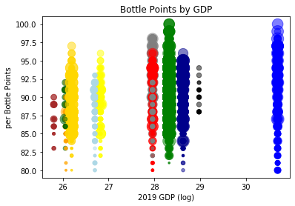
Does the size of the local economy affect the price or quality of wines?
Again, no perceptible patterns....

Slide 12
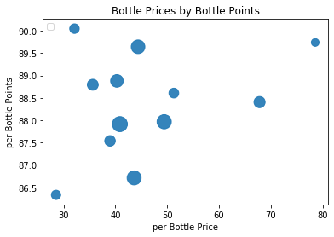
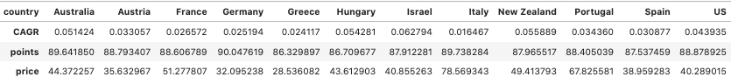
Does the growth of the local economy affect the price or quality of wines?
Looking at the prices of the wines relative to the quality by country there is no perceptible patterns
Area of the bubble shows the compounded annual growth rate of the GDP for each country

Slide 13

Twitter Sentiment of Wines
What is the most popular wine on Twitter?
Getting and cleaning the tweets
Number of tweets for each analysis was 2500 tweets
Used TextBlob for sentiment analysis of tweets

Slide 14
#Wine Positive tweets percentage: 30.337078651685392 % Negative tweets percentage: 2.247191011235955 % Neutral tweets percentage: 67.41573033707866 % \
Positive Tweet
RT @Leanne_Laine: My #wineart LoVin at 95&Vine in #Florida (find this #wine #art in many sizes: https://t.co/3lCbD6ibAY) #love #winetasting… Finally I got my hair topper! #cheers #hairtopper #finally #pretty #alopeciaawareness #dogs #pretty #chihuahua… https://t.co/lI2lDx7VHp RT @masonmalonecom: #Relax with a bottle of white #wine and a new book!

Slide 15
#Syrah Positive tweets percentage: 30.337078651685392 % Negative tweets percentage: 2.247191011235955 % Neutral tweets percentage: 67.41573033707866 % \
A rare treat on this freezing cold night in the Cape. The 2015 SIMELIA SYRAH was sold out ages ago and we only have… https://t.co/26yDTPKB2P showing characteristics of #cinsault & #syrah despite their absence from an English vineyard.
Average Rating: 93.333
Notes:
Negative tweet​

Slide 16
#Malbec Positive tweets percentage: 18.88888888888889 % Negative tweets percentage: 1.1111111111111112 % Neutral tweets percentage: 80.0 % \
The best red wines to drink now and later @TownandCountryMagazine @ZuccardiValleDeUco #AluvionalAltamira #Malbec
Average Rating: 93
Notes:
Positive tweet​

Slide 17
#PinotNoir Positive tweets percentage: 36.7816091954023 % Negative tweets percentage:2.2988505747126435 % Neutral tweets percentage: 60.91954022988506 % \ Average Rating: 89.61
Slight delay due to Covid-19 but here we go! New vintage finally going into the cellar. #PinotNoir #Chardonnay…
Notes:
Negative tweet

Slide 18
#lAMBRUSCO Positive tweets percentage: 28.571428571428573 % Negative tweets percentage: 2.857142857142857 % Neutral tweets percentage: 68.57142857142857 % \ Average Rating: 83

Slide 19
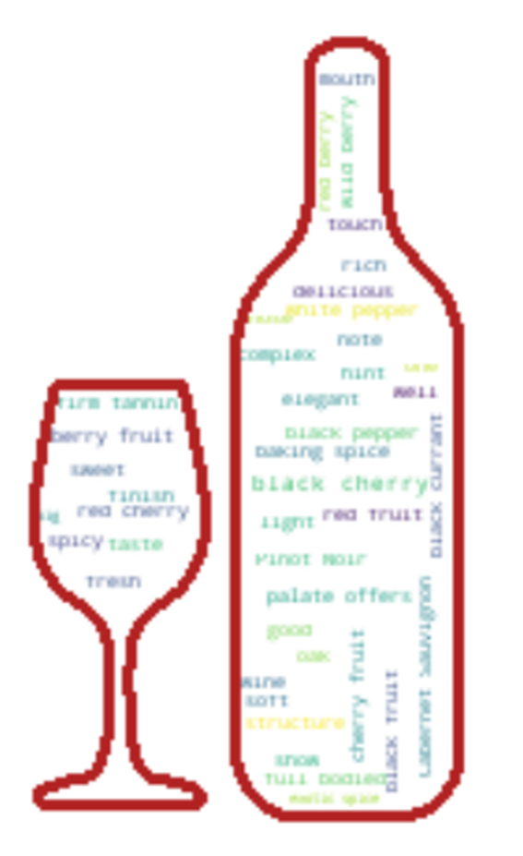
Conclusion
Does the country of origin affect wine prices or quality?
Looking at the prices of the wines relative to the quality by country there are a couple of perceptible patterns:
US is lower in price and has the highest quality
Italy is more expensive and also has the highest quality
The rest of the countries aren't quite as expensive as Italian wine
Does weather affect wine quality?
Average temperature with highest rating (99-100 points): 76-78F
Average rainfall with highest rating (99-100points): .29in, 3-3.2in
Does the growth of the local economy affect the price or quality of wines?
No
What is the most popular wine on Twitter?
Pinot Noir

